Slide 1

DEEPFAKE DETECTION USING VISION TRANSFORMER
Vikas Kashuvajjala
Vineela Ranabothu

Slide 2
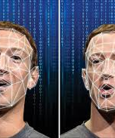
Introduction
A deepfake is a manipulated video or audio that appears genuine but is synthetic, often created using advanced AI algorithms.
Deepfakes can deceive, manipulate, and sow distrust by fabricating realistic-looking content that can spread misinformation and harm individuals or societies.
The first widely recognized instance of deep fake technology gaining attention occurred in 2017.

Slide 3
Existing System (CNN Model)
Deepfake detection using Convolutional Neural Network (CNN) models involves training the network on a dataset containing both authentic and deepfake videos or images.
The CNN learns patterns and features unique to deepfakes during this training process.
When presented with new content, the trained CNN can identify inconsistencies or artifacts characteristic of deepfakes, enabling it to distinguish between real and manipulated media.

Slide 4
Proposed System (Vision Transformer)
Deepfake generation using vision transformers involves adapting the transformer architecture, originally designed for natural language processing, to process visual data.
By feeding a sequence of image patches into the transformer model, along with positional encodings, it learns to capture spatial relationships and features within the images.
Through training on a dataset of paired real and manipulated images, the vision transformer learns to generate realistic deepfake images by synthesizing visual features in a manner consistent with the training data.

Slide 5
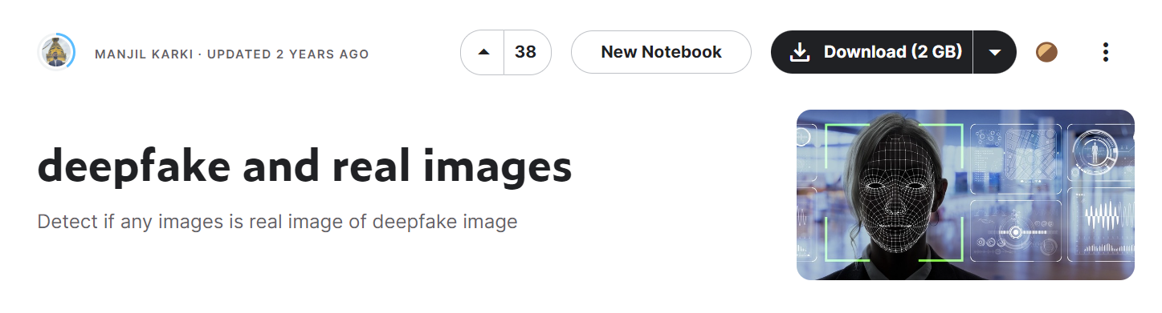
Dataset
The dataset you provided from Kaggle contains both deep fake and real images, which can be valuable for training and evaluating deepfake detection models.
The dataset consists of three subsets: Test, Train, and Validation.
Each subset contains both "Fake" and "Real" categories. There are 190,000 files in .jpg format, totaling 190,000 images.
The dataset provided is impeccably clean, devoid of any null values or missing entries.
Discover a vast collection of approximately 190,000 captivating .jpg images packed into a compact 1.8 gigabytes of storage.

Slide 6
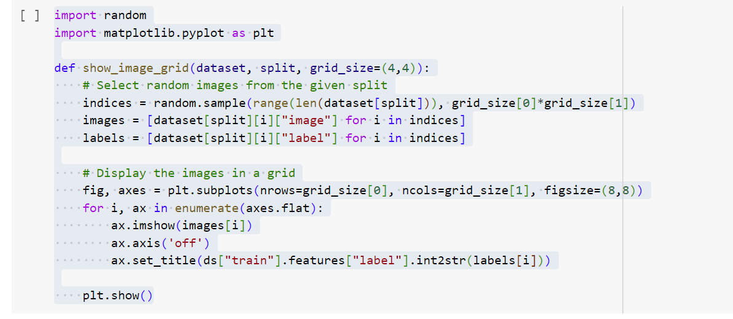
Implementation
This code defines a function `show_image_grid` to display a grid of random images and their corresponding labels from a dataset split. It selects random images from the specified split, then plots them in a grid using matplotlib. Each image is accompanied by its corresponding label. Finally, the grid of images is displayed using `plt.show()`.

Slide 7
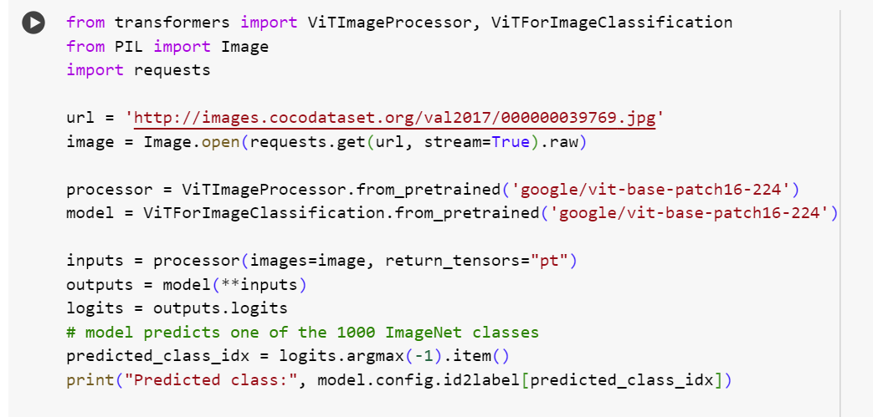
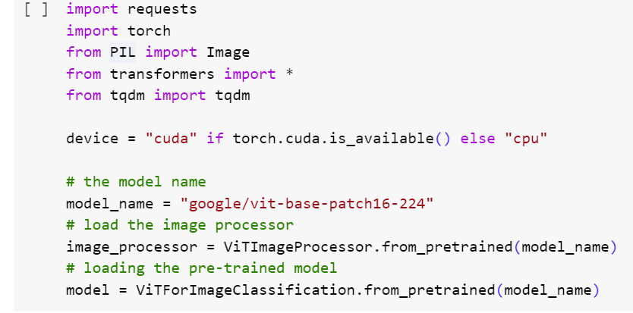
Implementation
This code snippet utilizes the Vision Transformer (ViT) model for image classification. It first checks for the availability of a CUDA-enabled GPU and then loads the pre-trained ViT model for image classification. It downloads an image from a specified URL and processes it using the ViT image processor. The processed image is then fed into the pre-trained ViT model, which predicts the class of the image from the 1000 ImageNet classes. Finally, it prints the predicted class label. Overall, the code demonstrates how to use a pre-trained ViT model to classify images.

Slide 8
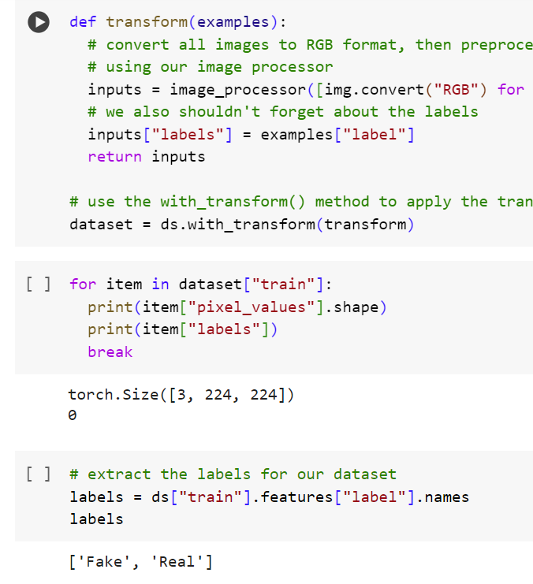
Implementation
This code defines a function transform that preprocesses images in a dataset by converting them to RGB format and applying the image processor. It returns the preprocessed inputs along with their corresponding labels. The dataset is then transformed on the fly during training using the with_transform() method. It iterates through the transformed dataset, printing the shape of pixel values and their corresponding labels for the first item.

Slide 9
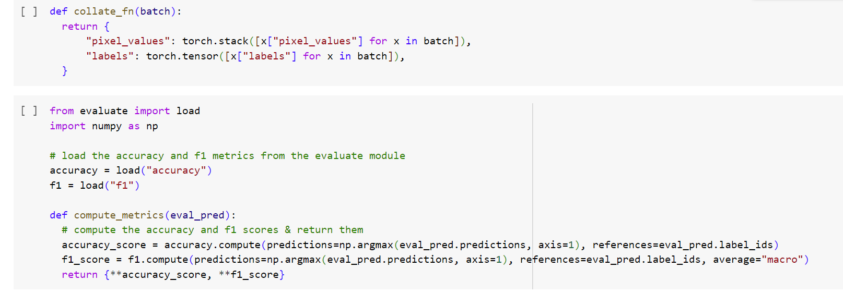
Implementation
This code snippet defines a function collate_fn that collates a batch of data during training. It stacks pixel values and converts labels into torch tensors.
It imports metrics for accuracy and F1 score computation from an external module called evaluate. Then, it defines a function compute_metrics that computes accuracy and F1 scores based on predictions and references, returning them as a dictionary.

Slide 10
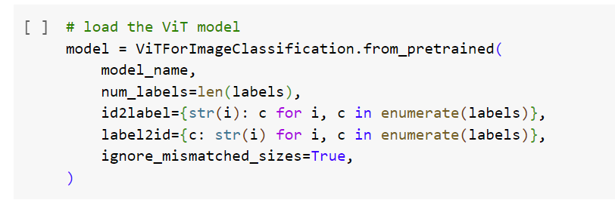
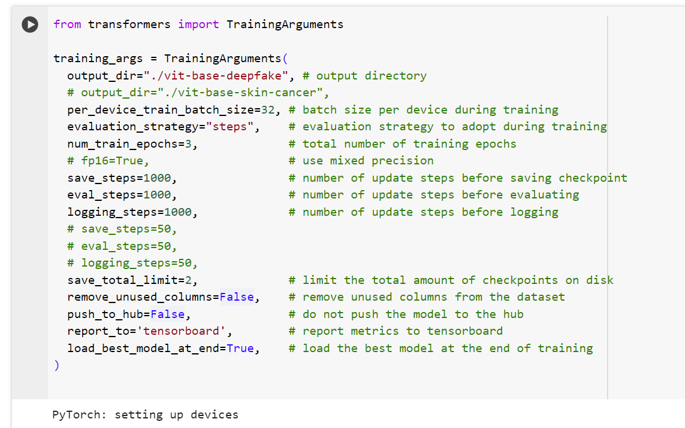
Implementation
This code loads a Vision Transformer (ViT) model for image classification using the ViTForImageClassification class from the Transformers library. It configures the model with the specified number of labels and mappings between label indices and names. The argument ignore_mismatched_sizes is set to True to handle cases where the model receives images of different sizes during training.
It also sets up training arguments using the TrainingArguments class from the Transformers library. This includes parameters such as the output directory for saving checkpoints, batch size, evaluation strategy, number of training epochs, logging settings, and whether to use mixed precision training. Additionally, it specifies to save the best model based on evaluation metrics at the end of training.

Slide 11
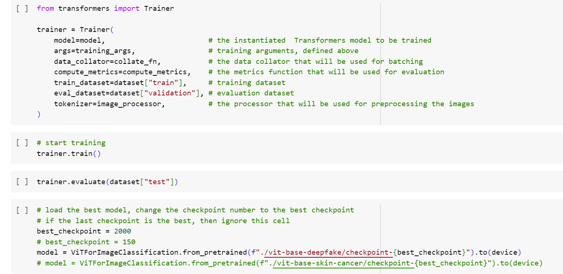
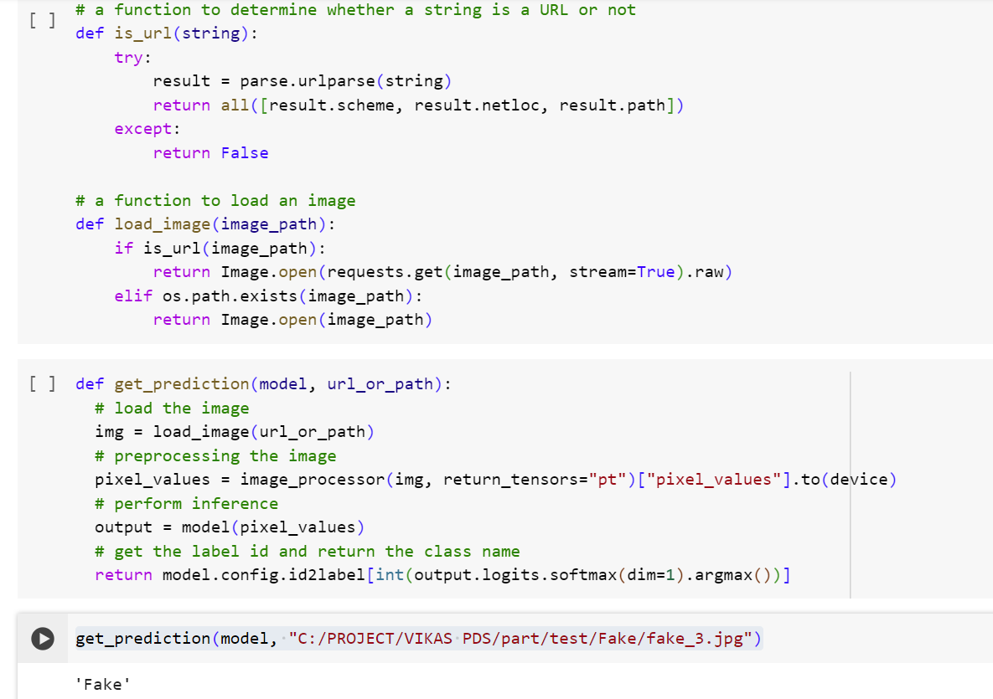
Implementation
This code utilizes the Trainer class from the Transformers library to train a Vision Transformer (ViT) model for image classification. It specifies the model, training arguments, data collator, metrics computation function, training, evaluation datasets, and tokenizer for image preprocessing.
The train() method initiates the training process, while the evaluate() method evaluates the trained model on the test dataset. It then loads the best-performing model based on the specified checkpoint number.
Additionally, the code defines functions to check if a given string is a URL, load an image from either a URL or a local path, and make predictions on new images using the trained model.

Slide 12

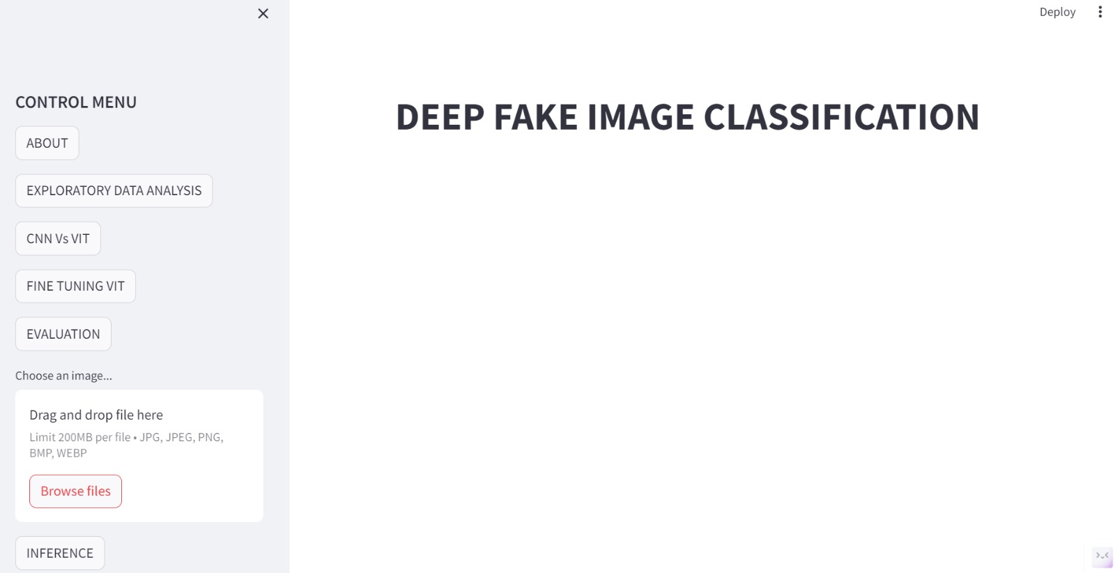
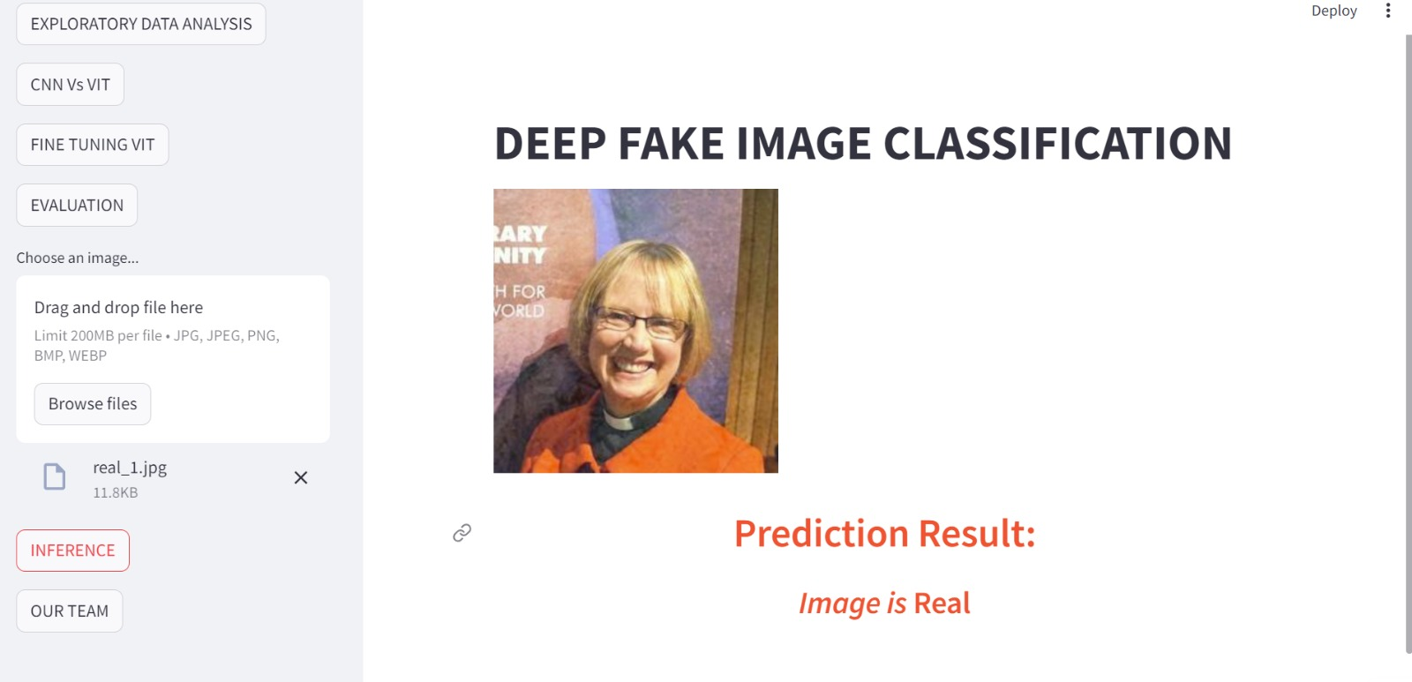
Output

Slide 13
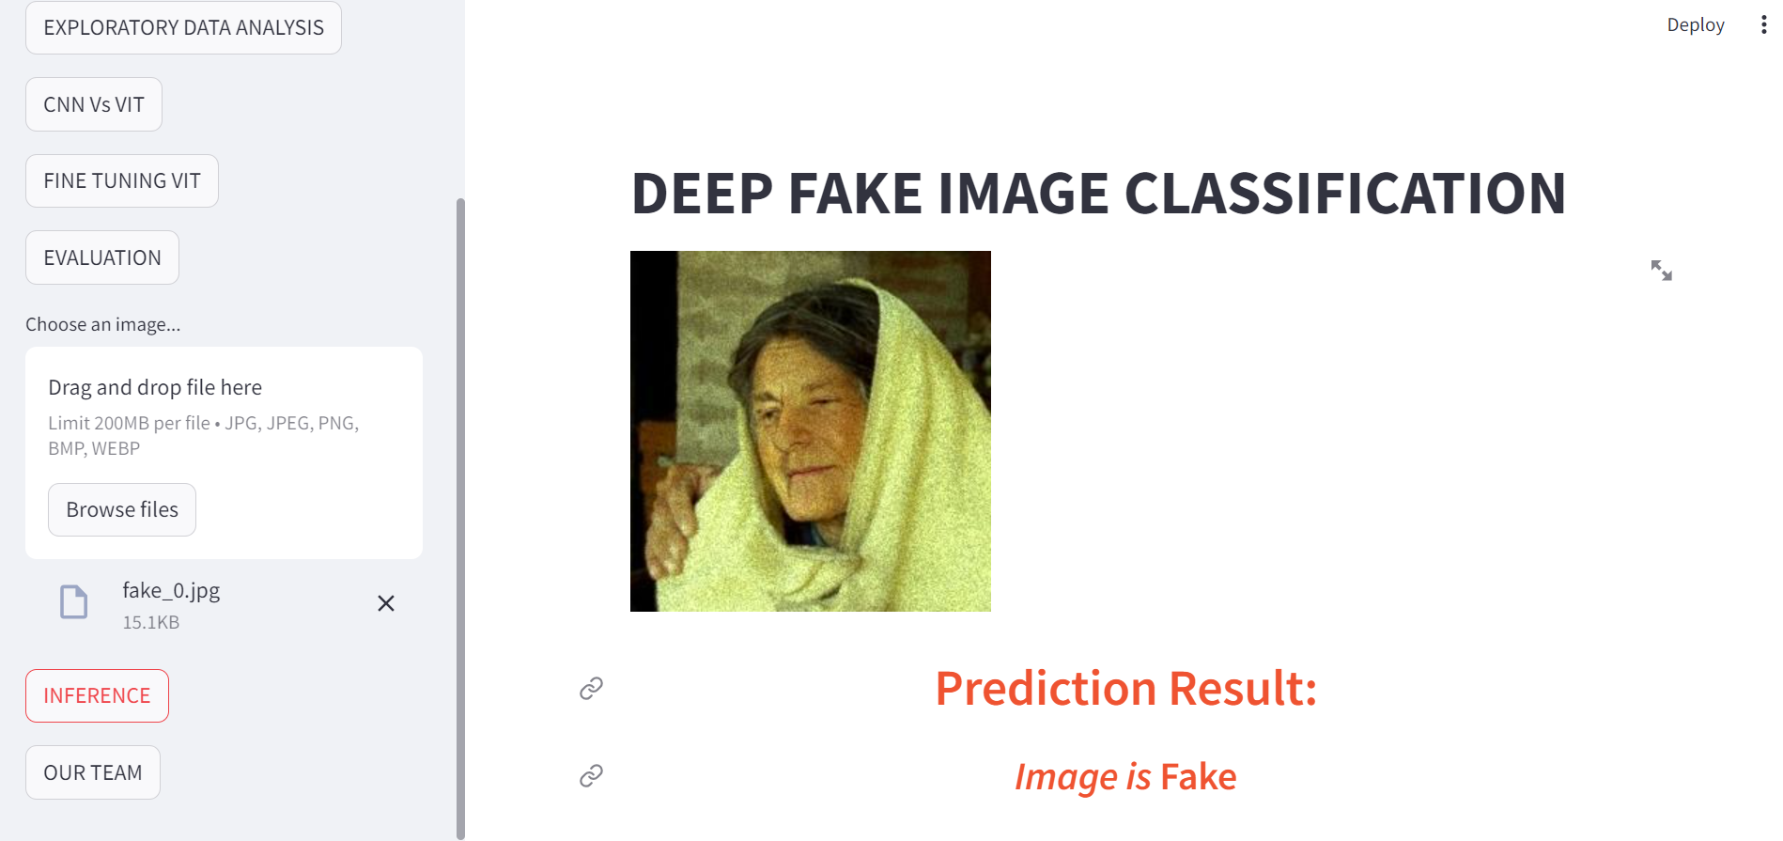
Output

Slide 14
Conclusion
In conclusion, the rise of deepfake technology presents a complex and multifaceted challenge to society.
While it offers innovative possibilities in entertainment and creative expression, its potential for misuse threatens to undermine trust, manipulate information, and erode the fabric of reality.
As we navigate this evolving landscape, it's crucial to remain vigilant, prioritize ethical considerations, and develop robust strategies for detection, regulation, and responsible usage to safeguard against the harmful impacts of deepfakes on individuals, communities, and the broader societal discourse.

Slide 15
References
"Fake Obarna created using AI video tool - BBC News," YouTube, uploaded by BBC News, 19 July 2017.
[2] "Artists create Zuckerberg 'deepfake' video," YouTube, uploaded by TimesLive Video.
[3] "Deepfake video of Volodymyr Zelensky surrendering surfaces on social media," YouTube, uploaded by The Telegraph, 17 March 2022.

